Slide 1

Public Health Emergency Preparedness and Response
Presented By:
Nathan Johnson, Local Emergency Response Coordinator

Slide 2
Agenda
Looking Back…
Responses
Yakima County Transportation Relay Exercise
Partnerships
Planning
Looking Ahead…
Preparedness vs Readiness
How Do We Get There

Slide 3

Looking Back….

Slide 4
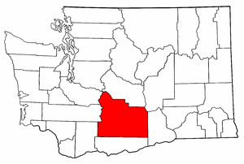
Responses
Wildfires
Measles
Floods
Influenza
September 2018
Regal Estates Water System E. Coli
February 2019
Lower Valley Dairy Cow Mortalities
June 2019
Yakima County Jail Hep A Exposure

Slide 5
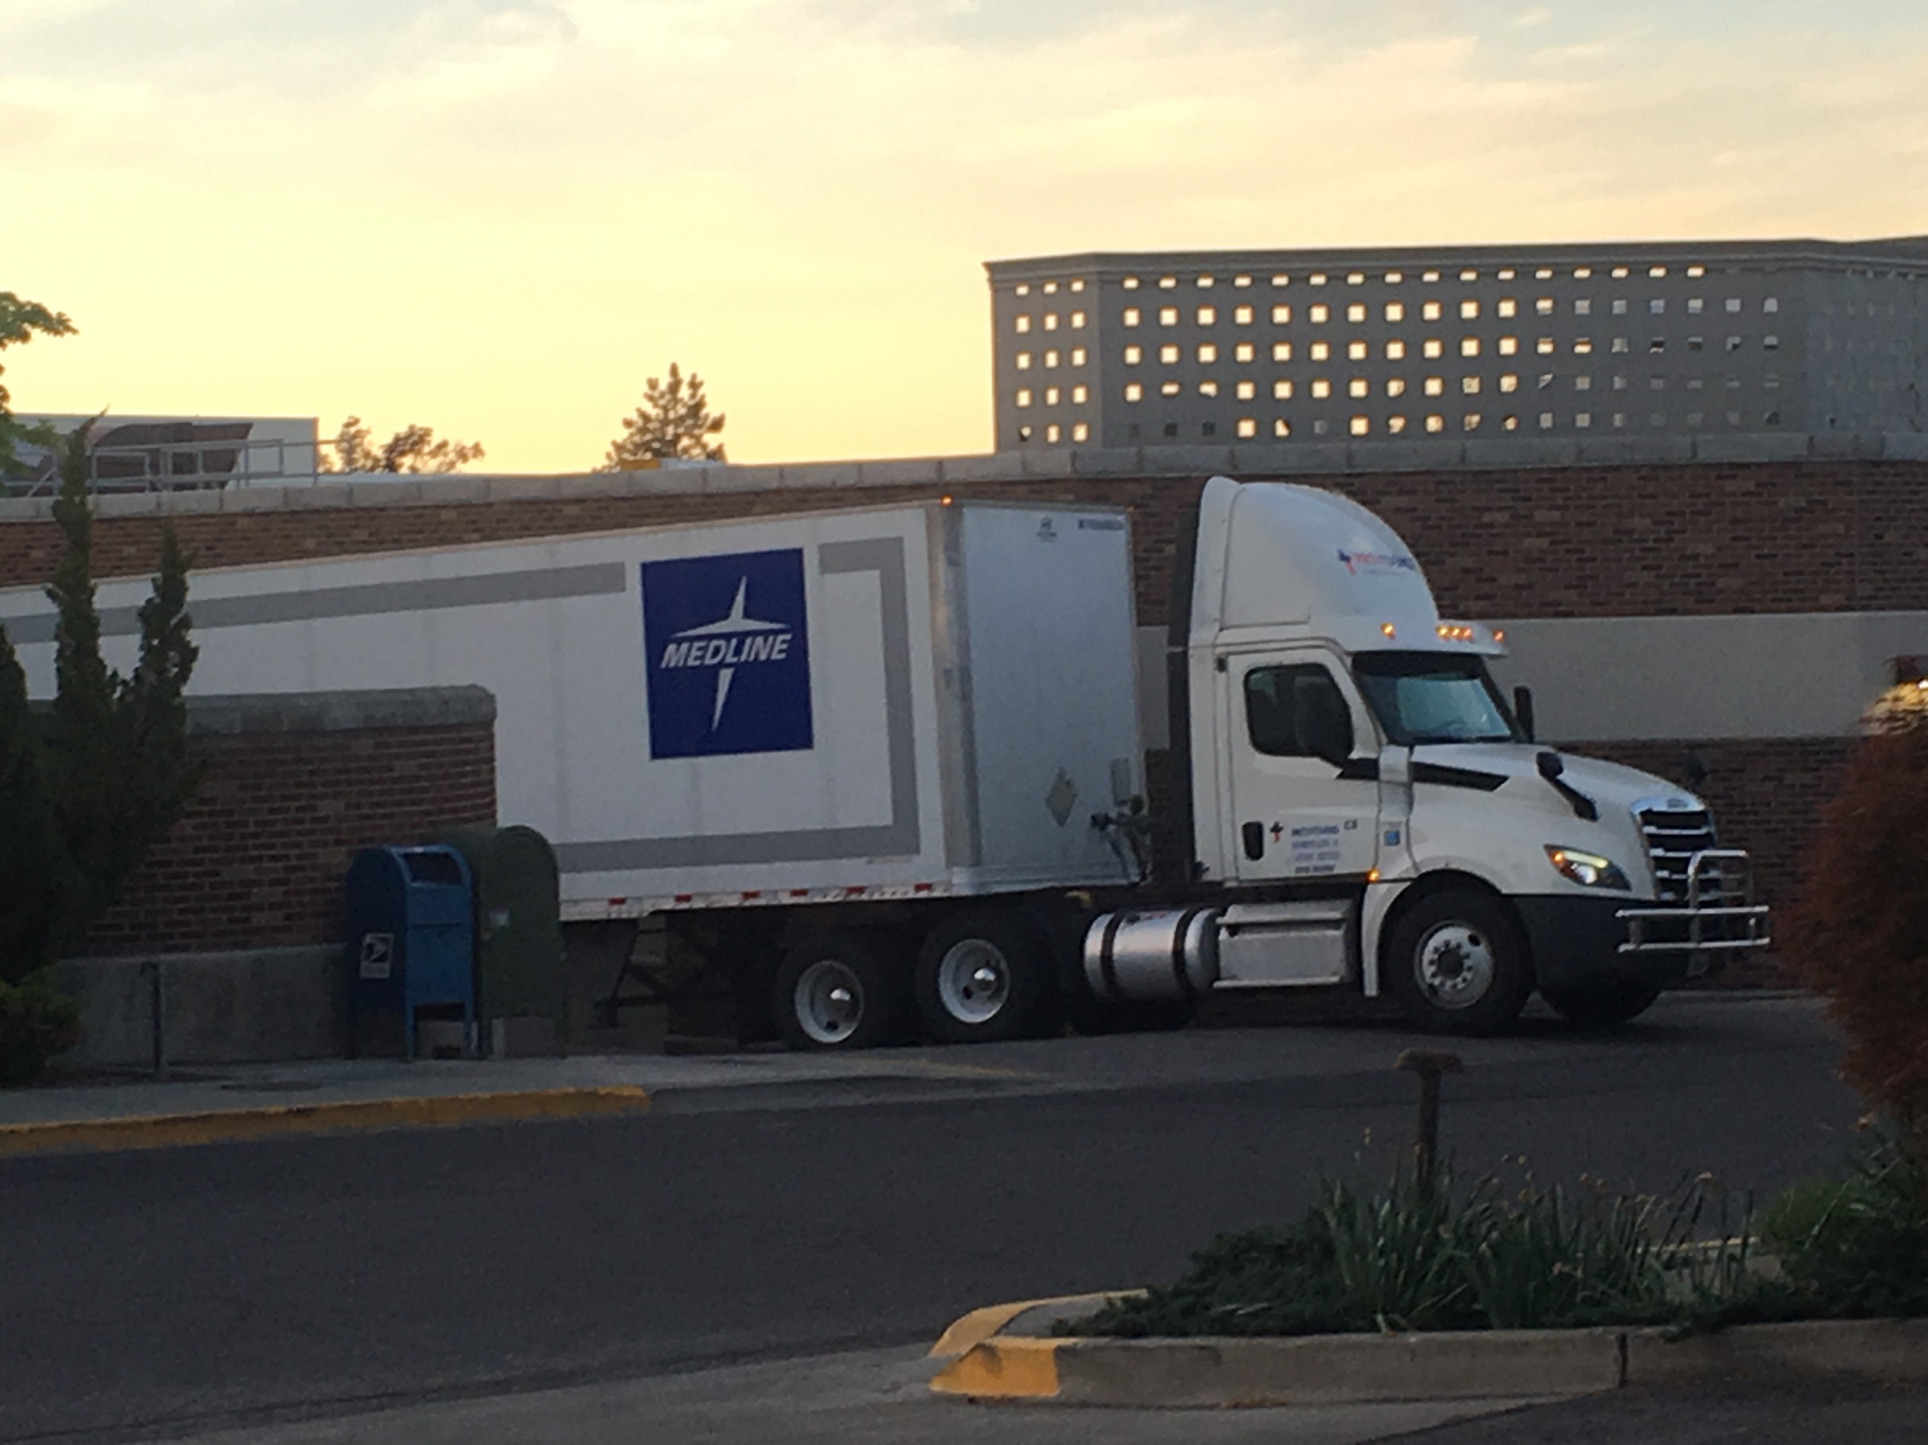
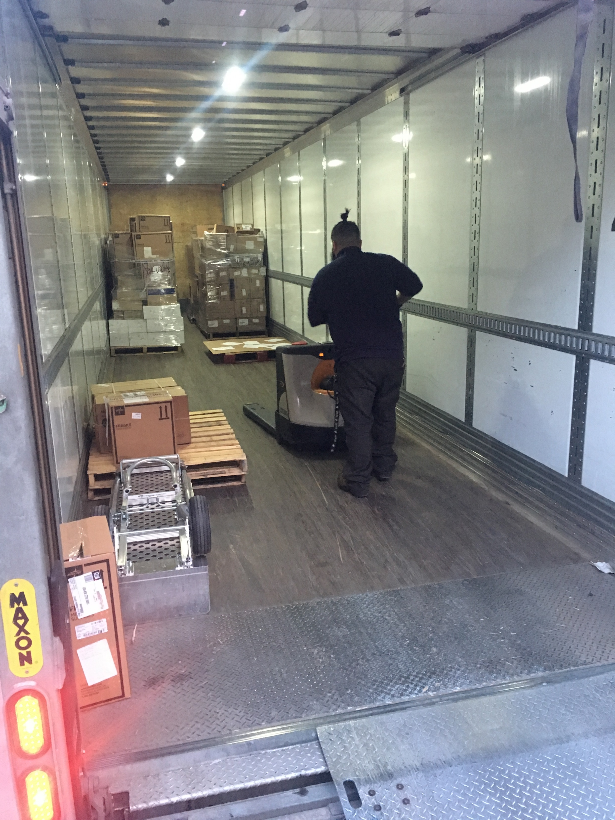
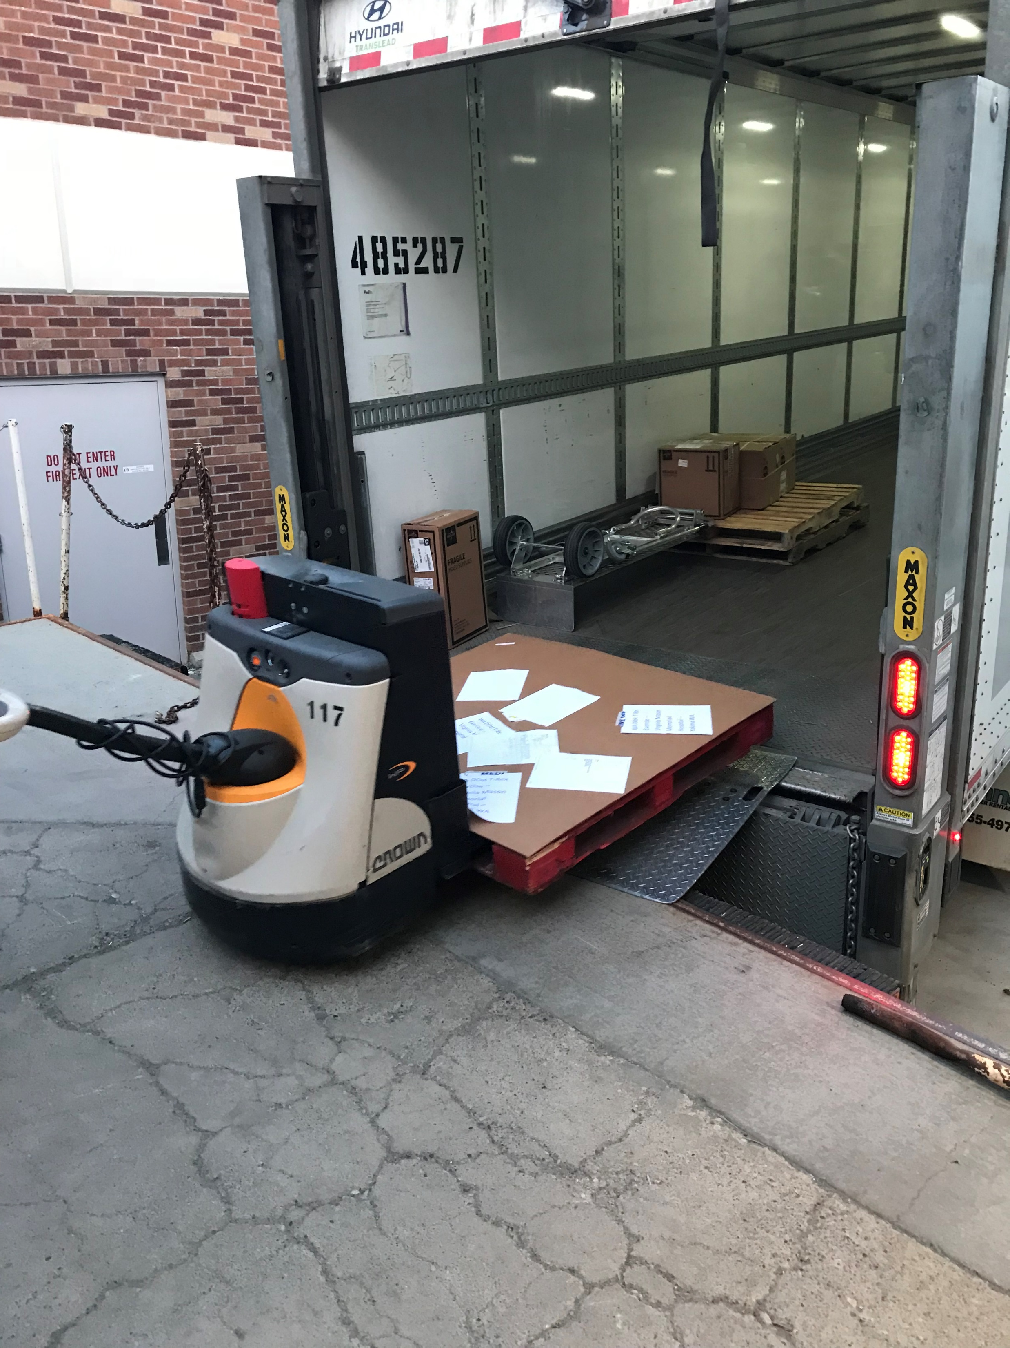
Yakima County Transportation Relay Exercise 2019 – May 2019
Goals
Activate YHD Emergency Operations
Receive medication from the Strategic National Stockpile
Set up a Point of Distribution (POD)

Slide 6
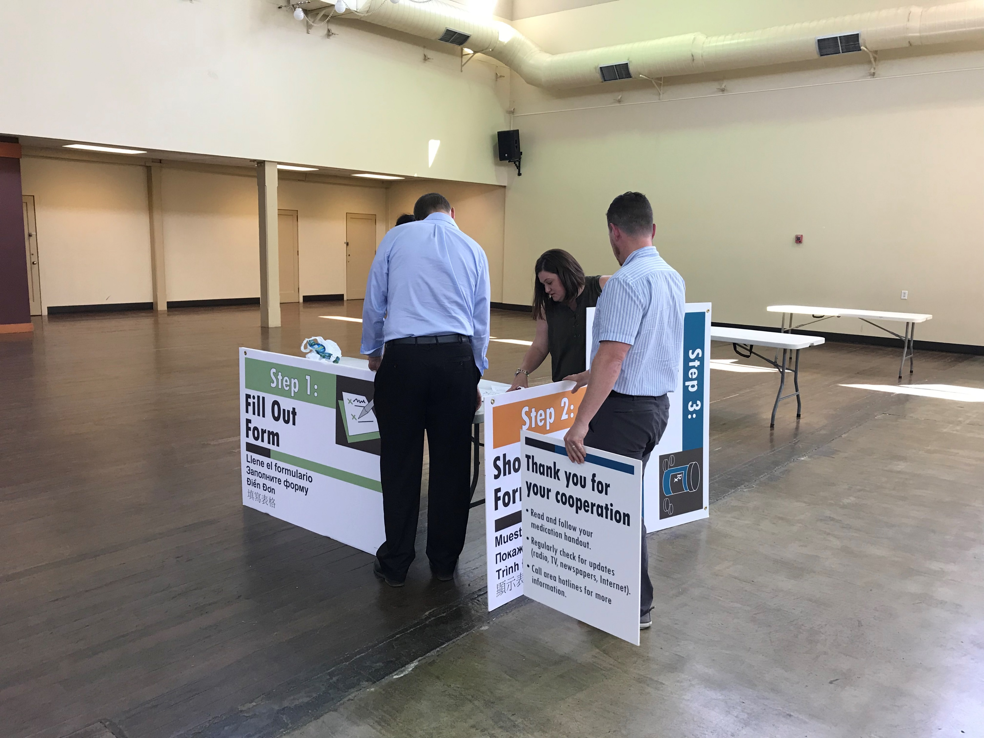
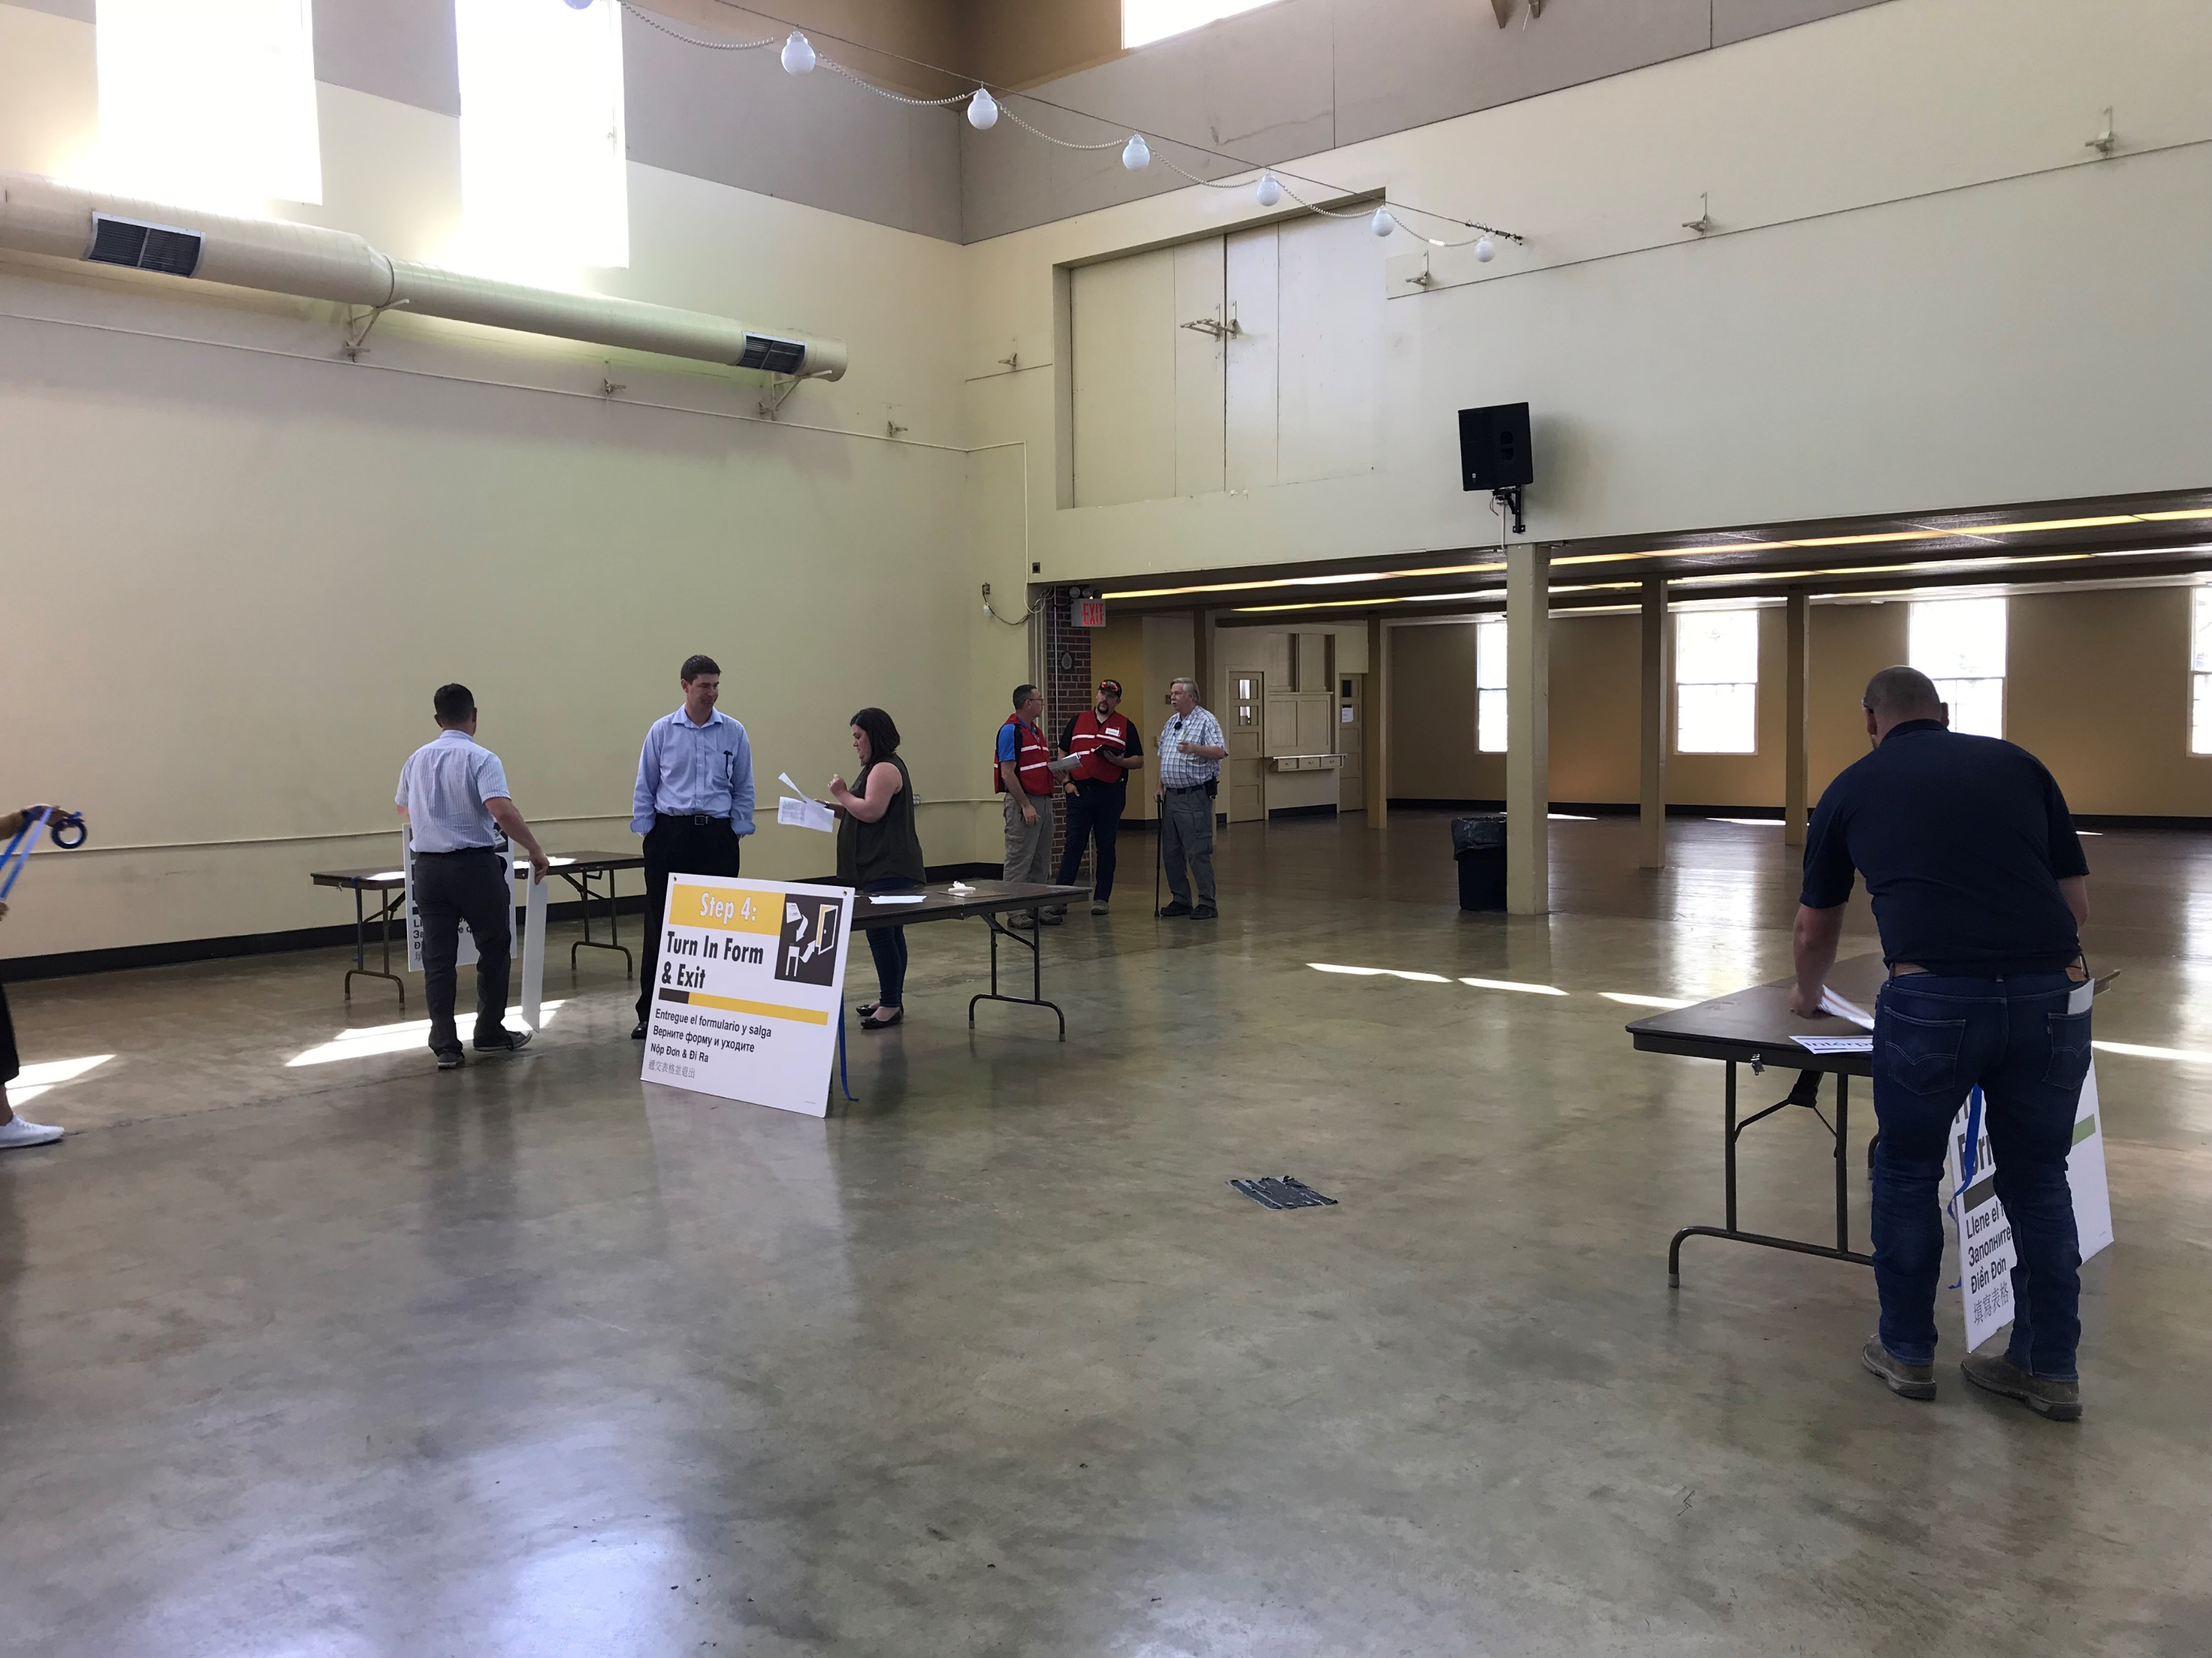
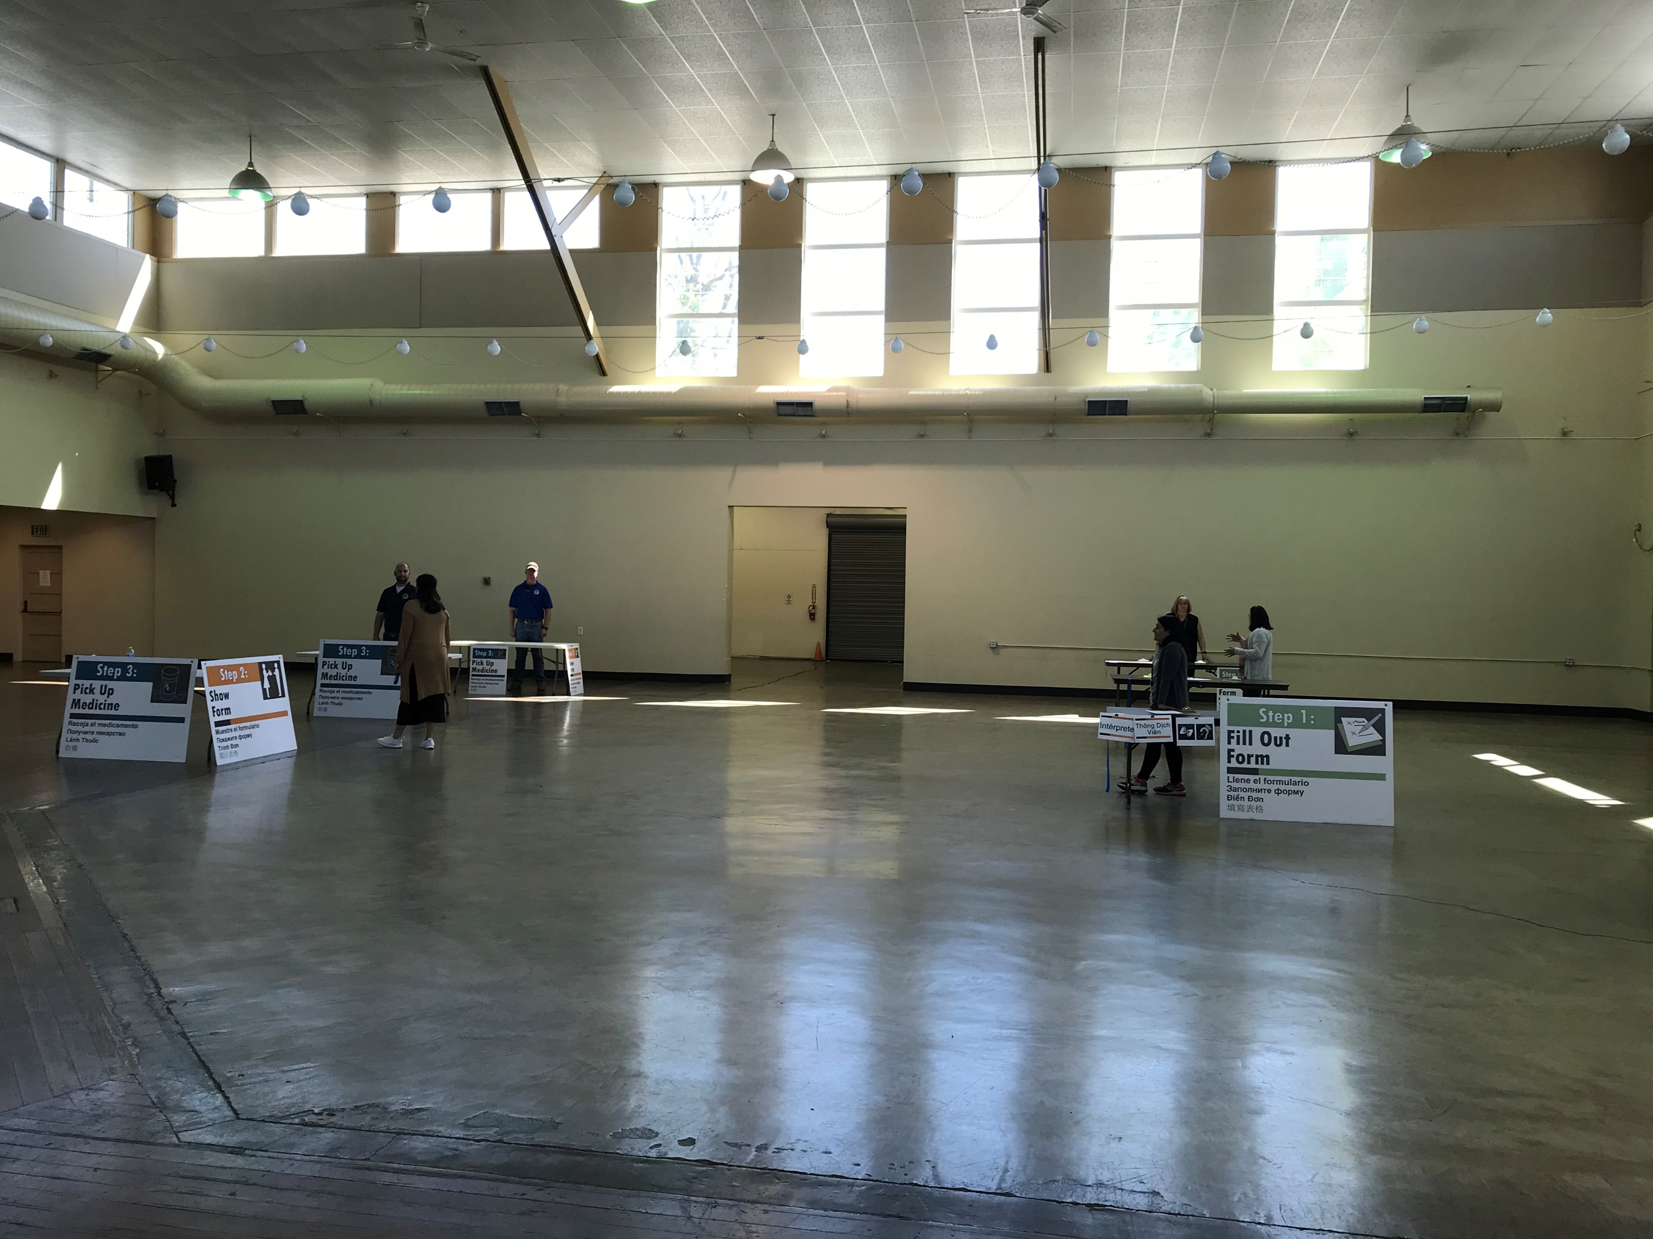
Yakima County Transportation Relay Exercise 2019 – May 2019
Partnering Agencies
Yakima Health District (YHD)
Virginia Mason Memorial Hospital (VMMH)
Washington State Dept. of Health (DOH)
Yakima Valley Office of Emergency Management (YVOEM)
REDI Healthcare Coalition
Central Washington State Fair
Medline Industries Inc.

Slide 7
Partnerships
National Association of County and City Health Officials (NACCHO)
Washington Department of Health
Emergency Preparedness and Response
Public Health Communications
REDI Healthcare Coalition
Neighboring Health Districts
Local…
Nationwide
Regional
Local
Statewide

Slide 8
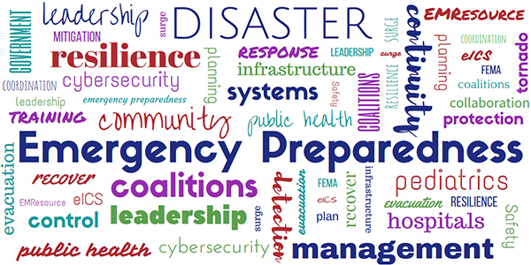
Yakima County Healthcare Emergency Preparedness Coalition
The goal of the Yakima Healthcare Emergency Preparedness Coalition is to provide an opportunity to foster healthcare emergency preparedness and partnerships throughout Yakima County

Slide 9

Yakima County Influenza Call
Infection Control + Emergency Preparedness Partners
Monthly Call
Increased Influenza surveillance throughout the county
Staffing, census, supply shortages

Slide 10
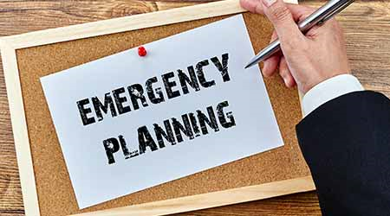
Planning
YHD
Crises and Emergency Response Communication Plan: Complete
Updating Basic Emergency Operations Plan: Draft
POD Trailer Plan: Draft
County Plans
Integrated in partners plans
Integrated in Comprehensive Emergency Management Plan
Primary agency ESF #8 Public health and Medical Services
Support agency for seven others

Slide 11

Looking Ahead….

Slide 12
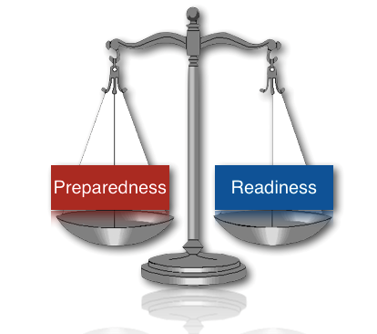
Preparedness vs Readiness
Preparedness:
Having plans and agreements in place
Testing those plans
Readiness:
Measuring our capability to successfully respond
State of being
Ensuring ability to execute functions
Building off realistic drills

Slide 13

How do we get there?
Planning
Medical Countermeasures
Emergency Operations Activation process
Staff training in emergency response
Education of plans
Education of different response topics
Exercises + Drills
Exercises to test plans
Drills to measure staff ability to function
Reviewing After Action Reports

Slide 14
Questions?

