Slide 1

Homeless Housing and Assistance Program Request for Proposal Informational Session
Published November 16, 2021

Slide 2
RFP Overview
5-Year Plan Goals
Project Type Categories
Funding
Timeline
Results-Based Accountability

Slide 3
Eligibility Requirements
General Eligibility
Program Type
Alignment with 5-Year Plan
Adherence to State and Federal Anti-Discrimination Laws
Participation in HMIS and Coordinated Entry
ESG- CV Project Types – Sub Types listed in RFP
Outreach
Budget Requirements
Budget Outline
Shelter
Rental Assistance
Related to COVID Response

Slide 4
Outreach: Street Outreach
Street Outreach meets the immediate needs of households experiencing unsheltered homelessness by connecting them with emergency shelter, housing, and/or critical health services. Outreach activities funded with ESG-CV must be consistent with CDC guidance related to street outreach and engaging people at increased risk of severe illness when contracting coronavirus, as well as established best practices.
Allowable costs:
PPE (e.g. masks, hand sanitizer, soap for distribution or for staff use)
Case Management
Emergency Health and Mental Health Services
Transportation
Hazard Pay*
Volunteer Incentives
Training
PROJECT TYPE
*Slide 7 Hazard Pay Limits

Slide 5
Outreach: Hygiene Services
ESG-CV funds may be used for costs of providing urgent, non-facility-based care to unsheltered households who are unwilling or unable to access emergency shelter, housing, or an appropriate health facility. To this end, funds may be used for portable hygiene services and the staffing, equipment, supplies and services to clean and maintain these facilities to support households experiencing unsheltered homelessness. Examples include handwashing stations and bathrooms (e.g. porta potties), shower trucks with soap and shampoo, and laundry services including mobile laundry trucks.
Allowable costs:
Handwashing Stations
Restrooms
Shower Trucks
Laundry Services
Supplies, maintenance and cleaning
PROJECT TYPE

Slide 6
Shelter: Day Shelter Services
Day Shelter means any facility providing daytime shelter with the primary purpose of meeting basic needs for persons experiencing homelessness or connecting them to services. This includes connections to Coordinated Entry or problem solving to meet the person’s housing needs.
PROJECT TYPE
Allowable Costs:
Essential Services |  | Shelter Operations
Case Management | Mental Health Services | Maintenance | Utilities
Child Care | Substance Abuse Treatment Services | Rent | Food
Education Services | Transportation | Security | Furnishings
Employment Assistance/Job Training | Services for Special Populations | Fuel | Supplies
Outpatient Health Services | Legal Services | Equipment | Hotel/Motel Vouchers
Life Skills Training | Hazard Pay * | Insurance | Volunteer Incentives

Slide 7
Hazard Pay Guidelines
May an employee receive hazard pay differentials or environmental differential pay if exposed to COVID-19 through the performance of assigned duties?
(1) To be eligible for the hazard pay differential, the agency must determine that the employee is exposed to a qualifying hazard through the performance of his or her assigned duties and that the hazardous duty has not been taken into account in the classification of the employee’s position. A hazard pay differential is not payable if safety precautions have reduced the element of hazard to a less than significant level of risk, consistent with generally accepted standards that may be applicable. (See 5 CFR 550.904-550.906 for further information and exceptions.) OPM does not determine when hazard pay differentials must be paid; agencies have the responsibility and are in the best position to determine whether duties performed by employees meet the regulatory requirements for hazard pay. Thus, agency managers, in consultation with occupational safety and health experts, must determine whether an employee is entitled to hazard pay on a case-by-case basis.

Slide 8
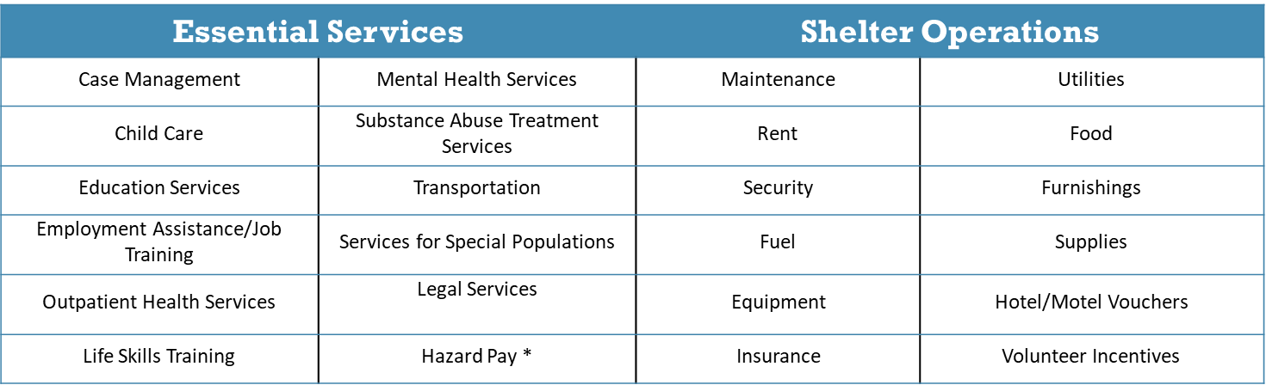
Shelter: Overnight Shelter Services
Overnight Shelter means any facility with the primary purpose of providing temporary overnight shelter for persons experiencing homelessness that does not require occupants to sign leases or occupancy agreements. Overnight Shelters provide short-term beds for households.
Allowable costs:
PROJECT TYPE

Slide 9
Rental Assistance: Domestic Violence Rapid Rehousing
Rapid Re-Housing assistance is available for persons who are literally homeless according to HUD's definition in Household Eligibility.
Allowable costs:
Rental Assistance
Rental Arrears
Rental Application Fees
Security Deposits
Last Month's Rent
Utility Deposits
Utility Payments
Moving Costs
PROJECT TYPE

Slide 10
Rental Assistance: Domestic Violence Prevention
Homelessness Prevention assistance is available for persons who are at imminent risk of homelessness or at- risk of homelessness according to HUD's definition in Household Eligibility.
Allowable costs:
Housing Search and Placement
Housing Stabilization Case Management
Mediation
Legal Services
Credit Repair
PROJECT TYPE

Slide 11
Rental Assistance: Landlord Incentives
ESG-CV may be used to pay for landlord incentives that are reasonable and necessary to assist households in obtaining housing. Grantees may not use ESG-CV funds to pay the landlord incentives an amount that exceeds three times the rent charged for the unit. Landlord incentives can include signing bonuses, security deposits, costs to repair damages, and extra cleaning fees.
Allowable costs:
Signing Bonuses
Extra Security Deposit (up to 3 months)
Repair Damages Over Deposit
Extra Cleaning or Maintenance
PROJECT TYPE

Slide 12
Timeline
Last Day to Submit Questions
December 10, 2021
Application Deadline
December 13, 2021
Award Notification
January 18, 2022
Contracts Provided to Service Providers January 25, 2022
Contracts Approved by BOCC
February 1, 2022
Note: All dates are anticipated

Slide 13
Required Agency Information
The following information will be required for the application.
Organization information (name, address, phone, fax, website, federal tax ID, DUNS number)
Program name
Type of program
Amount requested
Applicant information (name, title, phone, email)
Primary organization contact information (name, title, phone, email)
Type of organization
Program address(es)
(For nonprofits) Board documents (List of Board Members, charter, bylaws)
REQUIRED INFO

Slide 14
Scope & Goal Alignment
Project goals and intended outcomes are clearly identified including persons to be served and/or the use and purpose of the facility. The application includes a clear description of how funds will meet the described need and address the requirement to prevent, prepare for, and respond to coronavirus among individuals and families who are homeless or receiving homeless assistance and to support additional homeless assistance and homelessness prevention activities to mitigate the impacts created by coronavirus.
QUESTIONS

Slide 15
Project Timeline
Projects that can start within 20 days of award or are currently established.
QUESTIONS

Slide 16
Sustainability Plan
The agency has sufficient staff and experience to successfully maintain, monitor with additional funding sources identified to maintain operations for an identified period of time outside of contract terms.
QUESTIONS

Slide 17
Funding and Funding Sources
Project budget and funding priorities are clearly stated and consistent throughout the application. The applicant is requesting funds from other funding sources. The overall funding strategy for the project is realistic. If additional funding sources are needed to complete the project, projects have additional funding sources committed. Projects that have uncommitted funds may receive a lower score.
QUESTIONS

Slide 18
Funding and Funding Sources (Budget)
Complete a separate proposed budget using the template provided for each activity in your proposal. The costs reflected in the budget should be the activity(ies) you are applying for, not your total agency budget. Describe the sustainability of the other funding sources listed in your budget(s) supporting the activity(ies).
QUESTIONS

Slide 19
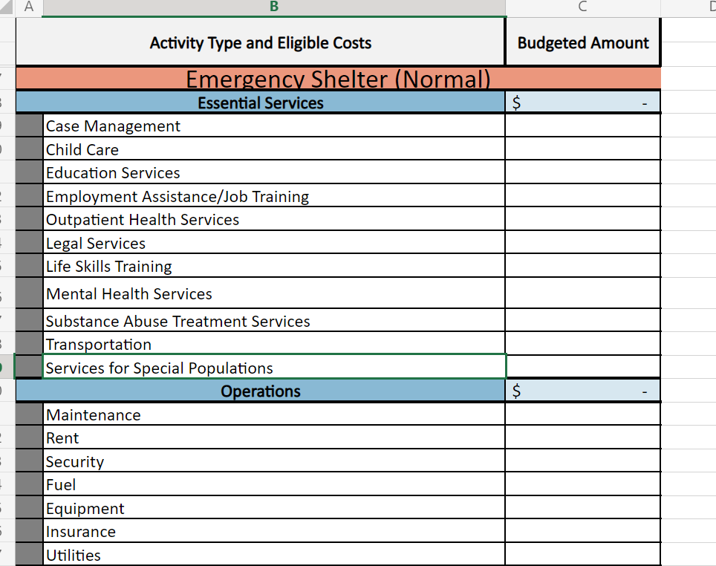
BUDGET EXAMPLE

Slide 20
Eligibility
Applicant has clear processes to ensure the benefit from the proposed project are residents of Yakima County Consortium cities and towns and/or unincorporated Yakima County.
QUESTIONS

Slide 21
Fiscal Management
Applicant has policies and procedures in place for financial Operations, addresses the framework the organization follows for internal controls and has described agency’s financial reporting, record keeping, accounting systems, payment procedures, and audit requirements. If applicable, applicant provides plan to address difficulties on their ability to manage their programs. Applicants that have been in any form of bankruptcy within the last seven years and/or have any legal actions or potential lawsuits pending, may receive a lower score.
QUESTIONS

Slide 22
Frequently Asked Questions
Q: Do you want resumes for everyone or just key staff?
A: Key Staff Only
Q: Does respite care qualify?
A: Yes
Q: Should we alter the budget template for additional costs?
A: No, Explain additional budget related information in the narrative
Q:Will we need letter of collaboration if we are collaborating with another group?
A: Yes, MOU’s are needed if applicant is naming, another organization to complete project.

Slide 23
Frequently Asked Questions
Q: Do we need to fill out an application for each asset?
A: No, multiple assets maybe combined into one application. However, a complete application is required for each project.
Q: Is here a budget limit on asset requests?
A: Yes, anything over five thousand dollars for any one asset will require additional requirements. If you are planning to do an asset request for more than five thousand, please reach out to our department for additional instructions ASAP.
Q: Can landlord incentives be used to help with costs that exceed the dollar amount allowed by Landlord Mitigation Funds?
A: There is no restriction on the LMP except that funds cannot overlap (double dipping). Otherwise, there is no issue with a household receiving additional funding.

Slide 24

Additional Questions Can be emailed until 12/10/2021
HumanServices@co.yakima.wa.us

