Slide 1

Review of Redline/Blueline changes
Chapter 2 – Natural Settings
Chapter 3 – Natural Hazards

Slide 2
What we’re doing today and how we’re doing it.
Two docs – you have
X -checklist – we have
This pres. as the guided tour

Slide 3

Chapter 3 – Natural Hazards
1. NATURAL HAZARD AND
MITIGATION – Narrative
2. Natural Hazards- GOALS AND
POLICIES

Slide 4
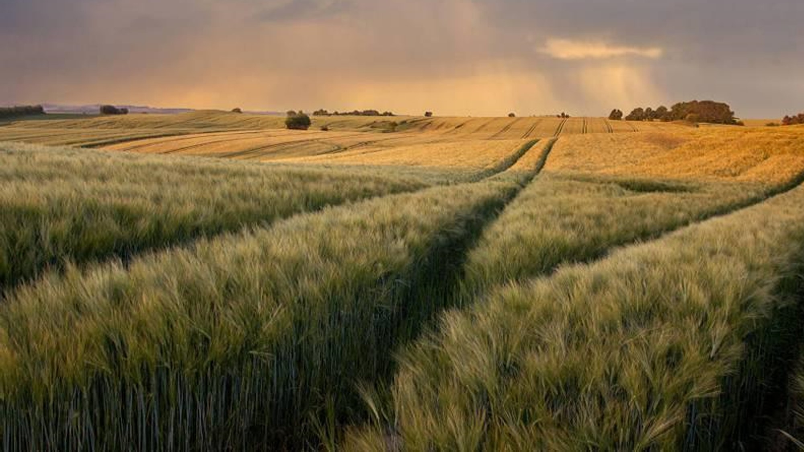
Narrative
3.1 Introduction
3.2 Hazard Mitigation Planning
3.3 Special Districts/Programs
3.4 Stormwater
3.5 Resilient and Sustainable Growth
Policies and Goals
NH 1 Flooding
NH 2 stormwater
NH 3 Wildfire
NH 4 Drought
NH 5 Extreme Heat
NH 6 Multi-Hazard
NH 7 Disaster Recovery
NH 8 Implementation

Slide 5
3.1 INTRODUCTION
3 updates (blueline)
1. ☐ Page 1, lines 8-17: 3.3.1:
  Lines 12-13: …"extreme weather events, such as drought, wildfire...."
  Lines 14-15 "Some of these are natural events, others are influenced by human activities."
  Line 17: "… and decisions made under growth management."
Notes:
Need to add lines not shown (few words changed)

Slide 6
3.2 HAZARD MITIGATION PLANNING
15 updates (blueline)
3. ☐ Page 2, line 8-28 3.2: Yakima County Mulit-Jurisdictional Hazard Mitigation Plan.
  Lines 10-11: "… For Yakima County and other jurisdictions or districts that with to participate..."
  Lines 12-14: " YVEM strives to capture informal status updates each year for accountability and awareness for the 5-year update. The following jurisdictions and districts are included in the HMP adopted in 2023:"
  Lines 16-28: participating jurisdictions.
4. ☐ Page 3, line 14-23: 3.2: simple additions to mitigation planning paragraphs.
  Lines 14-16: few stylistic additions.
  Lines 18-23: added Fire Management Assistance Grant and Building Resilient Infrastructure and Communities.
Notes:
Need to add lines not shown (ones with few words changed)

Slide 7
3.3 Special Districts/programs
6 updates
1. ☐ Page 3, line 31: 3.3.1: "… under RCW 86.15."
2. ☐ Page 3, line 38-40: 3.3.1.1: "… and follow Ecology's process for flood hazard management plans redefined by the 1991 Ecology guidelines."
3. ☐ Page 4, 3.3.1.1:
  Lines 11-17: added Cowiche Addendum to Upper Yakima CFHMP
  Lines 21-23: "Many of the recommendations have been completed since adoption, and the County wishes to soon update this plan once the flood maps have been updated by FEMA to reflect the suite of flood risk reduction actions implemented by the County."
  Lines 30-40: added Lower Yakima River Watershed CFHMP.
  Lines 42-2: added other CFHMPs not detailed in Ch 3.

Slide 8
3.3 Special Districts/programs
Continued
5 updates
1. ☐ Page 5, lines 4-24: 3.3.2: added National Flood Insurance Program and Community Rating System.
2. ☐ Page 5, line 37-44: 3.3.1.4: Added in-depth explanation for Yakima County's Hazus mapping strategies.
3. ☐ Page 7: Hazus photo mapping areas of interest and related tables.
4. ☐ Page 8, lines 5-10: 3.3.1.5: "Yakima County has been involved in efforts by American Rivers and BEF, etc. to insert many of their floodplain restoration/flood risk reduction projects into a “project pipeline”. The intent here is to show potential funders where money is needed and for what kind of projects."
5. ☐ Page 9 lines 24-45, Page 10 lines 1-3: 3.3.3: Yakima River Basin Water Enhancement Project/YBIP. Removed outdated information, stylistically revised the history of the program, and updated goals.

Slide 9
3.4 stormwater
1 update
1. ☐ Page 10 lines 26-45 - Page 11 lines 1-3: 3.4: stormwater in Yakima County section added. References history, state and federal requirements, permits, and the local stormwater authority.

Slide 10
3.5 Yakima County's strategy for resilient and sustainable growth new section
1. ☐ Page 11 line 29 - Page 15 line 11: 3.5: introduction to section and purpose. In-depth look at Yakima County's ecological factors.
2. ☐ Page 12, lines 8-20: 3.5: overarching goals for the new section.
3. ☐ Page 13, lines 13-41: 3.5: observed and projected changes to extreme weather and events. History of weather in Yakima County, introducing UW modeling tool. Section finishes on page 18 lines, 1 & 2.

Slide 11
3.5 Yakima County's strategy for resilient and sustainable growth continued new section
1. ☐ Page 16-24, all lines: 3.5: analysis of all the cumulative natural hazards and the potential impacts to the citizens of Yakima County.
  ☐ Page 18-20, line 25: Cumulative Natural Hazards: how all hazards are interconnected and how those combined effects can take a toll on Yakima County. Projections show more historic and unprecedented conditions that will affect everybody, but will have devastating effects on lower income households and rural communities
  ☐ Page 20, lines 28-32: Cascading Natural Hazards: human activities and climate change require that Yakima County fundamentally rethink how it manages growth, protects critical resources, and builds adaptive capacity for an uncertain future. The county faces an interconnected web of natural hazards that threaten every aspect of community life, economic stability, and environmental health.

Slide 12
3.5 Yakima County's strategy for resilient and sustainable growth continued
New Section
1. ☐ Page 16-24, all lines: 3.5: analysis of all the cumulative natural hazards and the potential impacts to the citizens of Yakima County.
  ☐ Page 20 line 34 – Page 21 line 6: Wildfire: relatively new threat to the county. States facts on a few large fires in the area. Shows how fires can threaten lives, economy, insurance rates, air and water quality.
  ☐ Page 21, lines 8-33: Drought: history of drought in Yakima County, noting emergency declarations, impacts to residential communities, municipal infrastructure, and agricultural impacts. Highlighting economic effects.
  ☐ Page 21 line 35 - Page 22 line 20: Flooding: brief history of the 1996 flood, highlighting historic damages, future risk to residential areas, critical infrastructures, and agricultural infrastructure.

Slide 13
3.5 Yakima County's strategy for resilient and sustainable growth continued new section
1. ☐ Page 16-24, all lines: 3.5: analysis of all the cumulative natural hazards and the potential impacts to the citizens of Yakima County.
  ☐ Page 22 line 22 – Page 23 line 14: Aquifer Protection: thorough explanation of aquifer ecology. Section shows the importance of aquifer protection for the environment, infrastructure systems, and economic resilience.
  ☐ Page 23 line 16 – Page 24 line 6: The Imperative for Integrated Planning: shows how important and how enmeshed all the natural hazards and their consequences can be. Call to action.

Slide 14
3.4 Hazard Mitigation
22 updates
1. ☐ Page 25: 3.4: flood tables added (acreage, buildings, and parcels in floodplains and floodways).
2. ☐ Page 26, lines 4-24: 3.4: more context to tables provided. Updated information about projects, grant programs, and levees in Yakima County.
3. ☐ Page 27, lines 13-14: 3.4.3: "In 2025, the Department of Ecology declared a drought in Yakima County for the third consecutive year."
4. ☐ Page 28, line 14: 3.4.5: "...an extreme weather, natural, or otherwise significant event."

Slide 15

chapter 3 natural hazards
Policy and goals
.

Slide 16
NH1: Flooding
1. ☐ Page 28-30:
  ☐ Page 28, lines 21-27: new purpose statement.
  ☐ Goal NH1: "Prevent the loss of life or property and minimize public and private costs associated with repairing or preventing flood damages from development in frequently flooded and or flood hazard areas."
  Page 28: NH1.1
  Page 28: NH 1.2
  Page 28: NH 1.3
  Page 28: NH 1.4
  Page 28: NH 1.5
  Page 29: NH 1.6
  Page 29: NH 1.7
  Page 29: NH 1.8
  Page 29: NH 1.9
  Page 29: NH 1.10
Page 29: NH 1.11
Page 29: NH 1.12
Page 29: NH 1.13
Page 29: NH 1.14
Page 29: NH 1.15
Page 29: NH 1.16
Page 29: NH 1.17
Page 30: NH 1.18
Page 30: NH 1.19

Slide 17
NH 2 stormwater management
1. ☐ Pages 30-31: NH 2:
  ☐ Page 30, Lines 4-9: new purpose statement.
  ☐ Page 30, Goal NH 2: "Prevent increased flooding from stormwater runoff."
    Page 30: NH 2.1
    Page 30: NH 2.2
    Page 30: NH 2.3
    Page 30: NH 2.4
    Page 31: NH 2.5
    Page 30: NH 2.6
    Page 30: NH 2.7

Slide 18
NH 3 flood control
1. ☐ Page 31: NH 3:
  ☐ Page 31, Goal NH 3: "Protect the hydrologic functions of natural systems to store and slowly release floodwaters, reduce flood velocities, and filter sediment."
    Page 31: NH 3.1
    Page 31: NH 3.2

Slide 19
NH 4 Geologic Hazards
1. ☐ Page 31-32: NH 4:
  ☐ Page 32, lines 1-6: new purpose statement.
  ☐ Page 32, Goal NH 4: "Protect the public from personal injury, loss of life, or property damage from geologic hazards."
    Page 32: NH 4.1
    Page 32: NH 4.2
    Page 32: NH 4.3
    Page 32: NH 4.4
    Page 32: NH 4.5
    Page 32: NH 4.6

Slide 20
NH 5 wildfire
1. ☐ Page 32-44: NH 5:
  ☐ Page 32 line 11 – Page 33 line 2: new purpose statement.
  ☐ Page 32, Goal NH 5: "Protect life, property, and ecosystems from wildfire hazards."
  Page 33: NH 5.1
  Page 33: NH 5.2
  Page 33: NH 5.3
  Page 33: NH 5.4
  Page 33: NH 5.5
  Page 33: NH 5.6
  Page 33: NH 5.7
  Page 33: NH 5.8
  Page 33: NH 5.9
  Page 34: NH 5.10
  Page 34: NH 5.11
  Page 34: NH 5.12
  Page 35: NH 5.13
  Page 35: NH 5.14
  Page 36: NH 5.15
  Page 36: NH 5.16
  Page 36: NH 5.17
  Page 37: NH 5.18
  Page 37: NH 5.19
  Page 37: NH 5.20
  Page 38: NH 5.21
  Page 38: NH 5.22
  Page 39: NH 5.23
  Page 39: NH 5.24
  Page 39: NH 5.25
  Page 40: NH 5.26
  Page 41: NH 5.27
  Page 41: NH 5.28
  Page 41: NH 5.29
  Page 41: NH 5.30
  Page 42: NH 5.31
  Page 42: NH 5.32
  Page 43: NH 5.33
  Page 43: NH 5.34
  Page 43: NH 5.35
  Page 44: NH 5.36
  Page 44: NH 5.37

Slide 21
NH 6 Drought
1. ☐ Page 45-47: NH 6:
  ☐ Page 45, lines 5-22: new purpose statement.
  ☐ Page 45, Goal NH 6: "Protect public health, safety, and welfare by identifying and mitigating drought hazards, prioritizing irrigation demand and aquifer protection, and through climate-resilient planning."
    Page 45: NH 6.1
    Page 46: NH 6.2
    Page 46: NH 6.3
    Page 46: NH 6.4
    Page 46: NH 6.5
    Page 46: NH 6.6

Slide 22
NH 7 extreme heat
1. ☐ Page 47-48: NH 7:
  ☐ Page 47, lines 2-17: new purpose statement.
  ☐ Page 47, Goal NH 7: "Protect public health, safety, and welfare by identifying and mitigating extreme heat hazards, prioritizing vulnerable populations and outdoor workers, through climate-resilient planning, equitable resource distribution, and evidence-based heat adaptation strategies."
    Page 47: NH 7.1
    Page 47: NH 7.2
    Page 47: NH 7.3
    Page 47: NH 7.4
    Page 47: NH 7.5
    Page 48: NH 7.6
    Page 48: NH 7.7
  Page 48: NH 7.8
  Page 48: NH 7.9
  Page 48: NH 7.10
  Page 48: NH 7.11
  Page 48: NH 7.12

Slide 23
NH 8 Multi-hazard
1. ☐ Page 48-49: NH 8:
  ☐ Page 48, lines 4-10: new purpose statement.
  ☐ Page 48, Goal NH 8: "Protect property, life, and health from impacts of multiple and cumulative natural hazards."
    Page 48: NH 8.1
    Page 48: NH 8.2
    Page 49: NH 8.3
    Page 49: NH 8.4
    Page 49: NH 8.5
    Page 49: NH 8.6

Slide 24
NH 9 disaster recovery
1. ☐ Page 49: NH 9:
  ☐Page 49, lines 4-9: new purpose statement.
  ☐Page 49, Goal NH 9: "Be prepared to recover from a major natural disaster."
    Page 49: NH 9.1
    Page 49: NH 9.2

Slide 25
NH 10 natural hazards resiliency implementation
1. ☐ Page 49-51: NH 10:
  ☐ Page 49, lines 14-25: new purpose statement.
  ☐ Page 49, Goal NH 9: "Provide guidance and reasonable processes to implement effective resiliency and sustainability policies."
  Page 50: NH 10.1
  Page 50: NH 10.2
  Page 50: NH 10.3
  Page 50: NH 10.4
  Page 50: NH 10.5
  Page 50: NH 10.6
  Page 50: NH 10.7
  Page 50: NH 10.8
  Page 50: NH 10.9
  Page 50: NH 10.10
  Page 50: NH 10.11
  Page 50: NH 10.11
  Page 50: NH 10.12
  Page 50: NH 10.13
  Page 50: NH 10.14
  Page 50: NH 10.15
  Page 51: NH 10.16
  Page 51: NH 10.17

Slide 26

Chapter 2 – Natural Settings
1. NATURAL Settings Narrative
2. Natural settings- GOALS AND POLICIES

Slide 27
Narrative
2.1 Introduction/Purpose
2.1.1 Horizon 2046
2.2 Existing Conditions
2.5 2026 Setting
2.6 Best Available Science
2.7 Critical Areas
2.8 Water Quantity/Water quality
2.9 Air Quality
2.10 Priority Habitats and Species
2.11 Resilient and Sustainable Growth
Policies and Goals
NS 8 Critical Areas
Ns 9 resiliency and Sustainability
Ns 10 Water Quality and Quantity
Ns 11/12 Surface Water
Ns 13/14 sTORMWATER
NS 15-18 Fish and wildlife habitat, Wetlands and Freq. Flooded
NS 19 Geologic Hazards
NS 20 Best Available Science

Slide 28
2.1 introduction/purpose
1. ☐ Page 1: 2.1: Line 17-38: Yakima County's economy is diverse, with significant contributions from agriculture, food processing, healthcare, education, manufacturing, and retail trade. The county is renowned for its agricultural industry, particularly its production of tree fruits, hops, dairy products, and wine grapes.

Slide 29
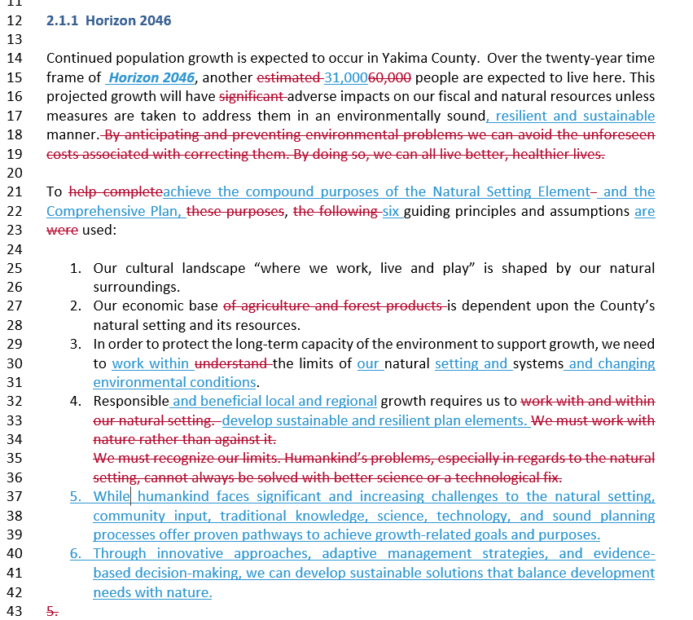
2.1.1 Horizon 2046

Slide 30
2.2 Existing Conditions
3. ☐ Page 3-9: 2.2: Lines 1- 42, 1-14x: Yakima County's natural setting has historically been a cornerstone of our economic prosperity. The long sunny days and cool nights have helped Yakima County become one of the top agricultural producing counties in the United States, generating a $4.5 billion agricultural economy that produces ...
---
The alluvium aquifer is generally unconfined, with its thickest, most productive units occurring in syncline centers. The Upper Aquifer is gen­erally associated with a shallow ground water table which supports the bulk of Yakima County's domestic water supplies.

Slide 31
2.5 2026 Setting
4. ☐ Page 10-17: 2.5: Line 6-36, x-27: Historic vs. 2025: Yakima River Basin Fish and Wildlife Populations. Comprising one of the most biodiverse ecosystems in Washington State with a diverse landscape spanning over 6,100 square miles from glaciated Cascade peaks exceeding 8,000 feet to Columbia Plateau lowlands at 340 feet elevation, the Yakima River Basin historically supported an estimated 500,000 to 900,000 adult anadromous fish annually. But as more of our natural resources have been put to use, the number and types of anadromous fish have rapidly declined. By the 1920s, the once awe-inspiring fish runs had dwindled to less than one percent of their historical numbers.
---
This systematic framework addresses four central questions: which species and habitats are conservation priorities, where they are located, what measures should protect them, and how effective current critical area efforts are proving. By grounding decisions in the best available science while maintaining flexibility for local implementation, this approach successfully maintains the basin's rich biodiversity while accommodating the agricultural, recreational, and residential land uses that define Yakima County—one of Washington's most ecologically diverse regions.

Slide 32
2.6 Best available science
5. ☐ Page 17-20: 2.6: Lines 16 -32x: Best Available Science (BAS) is a statutory requirement under Washington State's Growth Management Act (GMA) that mandates local governments to use current, scientifically valid information when designating and protecting critical areas. This requirement, codified in RCW 36.70A.172, ensures that environmental regulations are grounded in empirical evidence rather than speculation, protecting ecological functions while allowing for informed policy decisions that balance environmental protection with economic viability.
--
WAC 365-195-925 – Monitoring and adaptive management frameworks. Encourages monitoring programs to evaluate regulatory effectiveness and adaptive management to respond to new information.
.

Slide 33
2.7 Critical Areas
.
6. ☐ Page 19-20: 2.7: Lines 14-31x: Under RCW 36.70A.030(6), Washington State law identifies five types of critical areas that must be designated and protected using Best Available Science. Each type has distinct characteristics, functions, and protection requirements. The GMA also requires local jurisdictions to designate critical areas and adopt dev­elopment regulations which protect these them (RCW 36.70A.170(1)(d)). The Wash­ing­ton Administrative Code (WAC) Chapter 365‑190 identifies "Minimum Guide­lines to Classify Agriculture, Forest, Mineral Lands and Critical Areas" (hereafter referred to as Minimum Guidelines). Yakima County is required to consider the definitions found in the Minimum Guidelines when designating envir­on­mentally sensitive areas. The general ex­tent and scope of certain critical areas, such as the 100-year floodplain, over steepened slopes and wildlife habitat areas are depicted on the Yakima County Geographic Information System (GIS). Yakima County also maintains a more detailed series of maps specifically for administering its Critical Areas Ordinance.
--
As it was merged into the CAO, the County’s 1985 Flood Hazard Ordinance was updated to meet minimum federal and state req­uirements to maintain eligibility in the National Flood Insurance Program. Development meeting the vegetative management zoning requirements from nearby streams and wetlands, but remain in the 100-year floodplain, are processed through the flood hazard permit system administered directly by the Building Department.

Slide 34
Wetlands
7. ☐ Wetlands: Page 21: 2.7: Lines 4-16: Wetlands are areas inundated or saturated by surface or groundwater at a frequency and duration sufficient to support vegetation typically adapted to saturated soil conditions. Wetlands provide critical ecological functions including flood storage, water quality improvement, groundwater recharge, fish and wildlife habitat, and carbon sequestration.
--
Yakima County's wetlands range from high-elevation montane systems in the Cascades to riparian wetlands along rivers and streams to agricultural wetlands in the valley floor. The 2026 BAS update will incorporate the latest wetland science including updated management area requirements and mitigation ratios.

Slide 35
Critical Area aquifer recharge areas
(CARA’s)
8. ☐ Critical Aquifer Recharge Areas: Pages 21-22: 2.7: Lines 17-38 and 1-15: Aquifer recharge areas are areas with critical recharging effects on aquifers used for potable water supplies. These areas are characterized by permeable soils, shallow water tables, and significant connections between surface water and groundwater systems.
--
Aquifer recharge represents a fundamental component of the County's Growth Management Act Natural Settings and Hazards elements, enhancing regional resilience against extreme weather impacts while serving as a key sustainability measure to safeguard Yakima County's agricultural economy and natural resource heritage.

Slide 36
Fish and wildlife habitat conservation areas
9. ☐ Fish and Wildlife Habitat Conservation Areas: Page 22-23: 2.7: Lines 18-40 and 1-40: Fish and Wildlife Habitat Conservation Areas (FWHCAs) include areas with primary association for endangered, threatened, sensitive, or candidate species, as well as habitat for species of local importance. This includes both aquatic and terrestrial habitats.
--
Preserving a wide range of habitats provides numerous benefits to County residents, including: ensuring the protection of rare spe­cies and maintaining sensitive eco­sys­tems; reaping significant economic ben­efits from commercial and recreational fishing and hunting; preserving of cultures, lifestyles, and livelihood which center on fish and wildlife resources; and providing aesthetic and open space values which contribute to the overall quality of life..

Slide 37
Frequently flooded areas
10. ☐ Frequently Flooded Areas: Page 24-25: 2.7: Lines 1-40, and 1-5: Frequently flooded areas are lands subject to a one percent or greater annual chance of flooding (the 100 and 500-year floodplain). These areas are identified through FEMA Flood Insurance Rate Maps and supplemental hydrologic and hydraulic studies.
--
Projects that are proposed on parcels in special flood hazard areas are reviewed under the authority of Yakima County’s Critical Area Ordinance and Shoreline Master Program and require a flood hazard determination or flood hazard permit. Projects within special flood hazards areas must comply with building standards that are designed to protect property and not cause a rise in the base flood elevation.

Slide 38
Geologically Hazardous Areas
.
11. ☐ Geologically Hazardous Areas: Page 25-26: 2.7: Lines 7-40 and 2-22: Geologically hazardous areas include areas susceptible to erosion, sliding, earthquake, volcanic activity, or other geological events. These areas pose risks to health, safety, and property and require careful site-specific evaluation for development proposals.
--
Projects proposed in or near a mapped geological hazard are evaluated on a case-by-case basis under the authority of Yakima County’s Critical Area Ordinance and Shoreline Master Program. The proponent may be required to prepare a geological hazard report (typically mandatory in identified landslide areas) and receive a development authorization. Projects that could potentially contribute to an increase in the hazard, or in the risk to life and property on or off the site, would be required to mitigate risks to an acceptable level through design and construction practices.

Slide 39
2.8 Water Quantity
12. ☐ Water Quality: Page 32-34: 2.8: Lines 35-39x: As with much of the West, water in Yakima County serves competing, and often conflicting, uses. Securing certainty in our water supply has become an urgent crisis over the past three years as the County faces unprecedented challenges. Between 2023 and 2025, Yakima County experienced three consecutive years of severe drought—the first time since 1992-1994 that such sustained water scarcity has occurred. By September 2025, the Yakima Basin's five reservoirs reached only 20% capacity, the lowest level since recordkeeping began in 1971. Reliable access to water is necessary for direct human uses like household, agriculture, commercial and industrial operations, and for indirect human needs such as habitat and recreation. Climate change is fundamentally altering water availability, with reduced snowpack, earlier spring runoff, higher temperatures, and increased wildfire activity- all threatening the County's water security.
--
Climate projections indicate these challenges will intensify. Washington State Department of Ecology officials have characterized the current conditions as "the new normal," with more rain, less snowpack, earlier springs, hotter and drier summers, and an expectation that snow droughts will occur in four out of every ten years. Six of the last ten years have required drought declarations for some part of Washington State. Recent State Court decisions on Washington State Growth Management Act requirements have created a positive duty for Yakima County to ensure that water for development is legally and physically available. The County's Water Resource System (YCWRS), described in detail in the Utilities Element of Horizon 2046, represents one strategic response to these interconnected water supply challenges.

Slide 40
2.9 Water quality
13. ☐ Air Quality: Pages 37-39: 2.7: Lines 10-43, 2x: The water quality of our streams, lakes, and groundwater influences the domestic, economic, recreational, and natural environments of Yakima County. Many industries require clean water for manufacturing processes. As growth and development have increased, so have the problems associated with maintaining water quality, while the three consecutive years of severe drought (2023-2025) have intensified water quality challenges through reduced streamflows, elevated water temperatures, and concentrated pollutant loads that threaten both human health and aquatic ecosystems.
--
Through these integrated approaches—combining regulatory oversight, voluntary stewardship, technical assistance, monitoring and research, emergency response, and multi-stakeholder collaboration—Yakima County can work toward the goal of clean, safe, and abundant water for all beneficial uses even as environmental pressures intensify in the decades ahead.

Slide 41
2.9 Air quality
14. ☐ Air Quality: Pages 39-41: 2.9: Lines 15-43, 1-30x: Air quality in Yakima County faces mounting challenges from multiple sources, with wildfire smoke emerging as a critical and increasingly frequent threat to public health and quality of life. Between 2024 and 2025, the region experienced extended air quality alerts due to wildfire smoke from regional fires including the Western Pines Fire, Pomas Fire, and Hope Fire. These smoke events, combined with the County's semi-arid climate and geography, create complex air quality challenges that demand coordinated action across all sectors. While we all contribute to air quality problems through our daily activities, the convergence of prolonged drought conditions and increased wildfire activity has fundamentally altered the region's air quality landscape and requires adaptive management strategies for the decades ahead.
--
Agricultural best management practices should address dust control from field operations, efficient fertilizer application to reduce ammonia emissions, and conservation tillage practices that improve soil health while reducing particulate emissions. Coordination between the County, YRCAA, fire districts, conservation districts, health department, emergency management, and community organizations creates the collaborative framework necessary to protect air quality through both day-to-day emission reductions and emergency response to episodic wildfire smoke events that increasingly define summer air quality conditions in Yakima County.

Slide 42
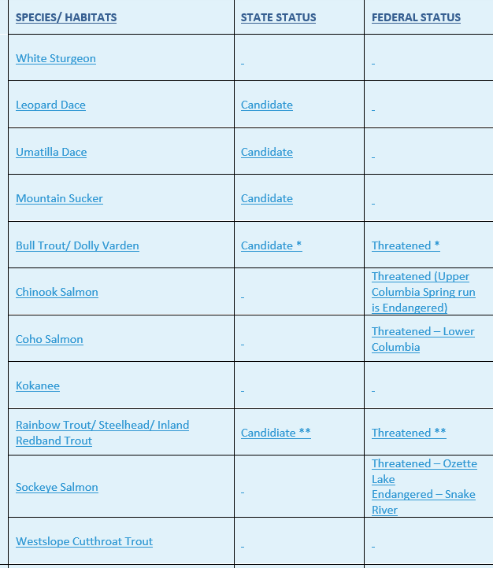
2.10 Priority habitats and species
15. ☐ Priority Habitats and Species: 2.10 Pages: See Table – provided by WDFW, October 2025.

Slide 43
2.11 resilient and sustainable growth
16. ☐ Resilient and Sustainable Growth:2.11 Pages 57-63, Lines 36-42, 13-18x The Climate Resiliency and Sustainability Element is included here for use in Critical Area Ordinances and is based on Best Available Science and is pursuant to Second Engrossed Substitute House Bill 1180 (2023), which amended the Growth Management Act (GMA) under RCW 36.70A.070(8) to require mandatory climate change planning. This element establishes a comprehensive framework for identifying, preparing for, and adapting to the significant climate-related risks facing Yakima County, with the overarching goal of ensuring the resilience and sustainability of critical areas, shorelines, property, life, health, and the economy through…
Chapter 3, Natural Hazards provides the implementation and policy and goal detail for Yakima County’s Resilience and Sustainability Strategy.
--
Often this analysis can be done in terms of outright dollars and cents. Yet our actions should also be evaluated for their effects on the quality of life we enjoy today and want to see for our children. Sustainability means leaving something for the next time, the next generation. This practice applies equally to the streams we divert water from. We need to look closer at the long term costs and benefits of our activities. This includes the operation of large scale extractive industries and our individual daily actions.
2.13 Wildfires, Extreme Heat, Flooding and Drought- Also see Chapter 3.

Slide 44
Volunteer stewardship program (VSP)
.
17. ☐ Pages 64-65, 2.12: Lines 35-42, and 1-14: Soil Moisture-Based Drought Monitoring for the South Central Region.
2.12 VSP and Agriculture (reference only. 2025 and 2026 VSP Reports will be added)

Slide 45
chapter 2 natural settings
Policy and goals
.

Slide 46
NS 8: Critical Areas General
Pages 74-75
Purpose Statement 8: Critical Areas are an important part of the natural setting in Yakima County. Their protection is required by the Growth Management Act and important to the quality of life of the residents of this county. Critical Areas include groundwater, fish and wildlife priority species and habitat, wetlands, frequently flooded areas, and geologic hazards. The protection of critical areas must include approaches based on Best Available Science, and processes for implementation.
GOAL NS 8: Establish critical areas protection for environmentally sensitive areas.
☐ NS 8.1: Update the 2004 Best Available Science Report. Require the use of the best available science to develop regulations to protect the functions and values of critical areas, including shorelines. Develop resiliency measures for flood, wildfire and drought, air quality and extreme heat hazards. Sustainability will provide benchmark principles and standards. Adaptive Management and High-Resolution Change Detection (e.g., imagery and GIS analysis) will provide a monitoring approach.
Page 74 - NS 8.2
Page 74 - NS 8.2
Page 74 - NS 8.3
Page 75 - NS 8.4a
.

Slide 47
NS 9: resiliency and sustainability – climate change
NS 9: Resiliency and Sustainability - Climate Change (Pages 76-79)
Purpose Statement: Building resilience and sustainability is fundamental to Yakima County's ability to thrive under changing climate conditions. Climate resilience planning is required by ESHB 1181 and essential to protecting critical areas, infrastructure, agriculture, the regional economy, and community wellbeing. Resilience encompasses preparedness for extreme weather events, adaptation to changing conditions, protection of vulnerable populations, critical areas, and sustainable resource management. Resilience strategies must include approaches based on Best Available Science, equitable resource allocation, nature-based and or geoengineered solutions, and monitoring and adaptive management for implementation.
GOAL NS 9: Ensure the resilience and sustainability of critical areas, shorelines, property, life, health, and the economy through preparation, survival, and recovery from extreme weather events and cumulative natural hazards.
1. ☐ NS-9.1: Update the 2004 Best Available Science Report - Require the use of best available climate science, including projections from the University of Washington Climate Impacts Group, NOAA models, USGS data, and other credible sources, to inform all land use planning, development regulations, and critical area protections. Planning decisions shall account for changing precipitation patterns, reduced snowpack, increased wildfire frequency and severity, extended drought periods, and temperature increases affecting water resources and ecosystems.
Page 75 – NS 9.1 Page 77 – NS 9.8
Page 75 - NS 9.2 Page 77 – NS 9.9
Page 76 – NS 9.3 Page 77 – NS 9.10
Page 76 – NS 9.4 Page 77 – NS 9.11
Page 76 – NS 9.5 Page 78 – NS 9.12
Page 76 – NS 9.6 Page 78 – NS 9.13
Page 76 – NS 9.7 Page 78 – NS 9.14
Page 78 - NS 9.15

Slide 48
NS 10: water quantity
NS 10: Water Quantity - Groundwater And Critical Aquifer Recharge Areas (CARAS) (Pages 78-81)
Purpose Statement: Groundwater and Critical Aquifer Recharge Areas (CARAS) are essential for maintaining groundwater quality and quantity that support domestic water supply, agricultural irrigation, industrial uses, flood storage and attenuation, stream base flows, wetland hydrology, and ecosystem functions in Yakima County's semi-arid climate. Designation and protection of CARAs is required by the Growth Management Act under RCW 36.70A.060 and necessary to prevent irreversible contamination and depletion….
GOAL Maintain and manage the quality of the groundwater resources in Yakima County in compliance with state water quality standards and engage opportunities to implement Managed Aquifer Recharge and other actions to protect and enhance the quantity of groundwater resources.
☐ NS 10.1: Identify and map important aquifers, critical aquifer recharge areas, and surface waters (no changes to 10.2 – 10.10)
Page 80 - NS 10.11 Page 80 – NS 10.12 Page 80 – NS 10.13
Page 80 – NS 10.14 Page 80 – NS 10.15 Page 80 – NS 10.16

Slide 49
NS 11-12 Surface Water enhancement
NS 11: Surface Water Enhancement (Pages 85-86)
Purpose Statement: Surface water quality and quantity directly affect public health, agricultural viability, and ecosystem integrity.
GOAL NS 11: Enhance the quantity and quality of surface water
1. ☐ NS 11.1: Support local and regional cooperative efforts which help to accomplish this goal, such as the Yakima Basin Integrated Plan
2. ☐ NS 11.3: Participate in water quality improvement planning and implementation efforts
3. ☐ NS 11.4: Control and reduce both point source and nonpoint source pollution that degrades surface water quality

Slide 50
NS 13 Stormwater
NS 13: Stormwater Flooding Prevention (Pages 86-87)
Purpose Statement: Yakima County's framework for protecting water quality and managing stormwater in compliance with the federal Clean Water Act and Washington State's Eastern Washington Phase II Municipal Stormwater Permit. They describes the County's Stormwater Management Program (SWMP), which implements eight required program elements designed to reduce pollutant discharge from stormwater runoff, protect citizens from drainage damage, and ensure that development activities do not create water quality or quantity problems. Through this comprehensive approach, the County aims to safeguard both surface and groundwater resources while meeting regulatory requirements and addressing current and emerging water quality concerns.
GOAL NS 13: Prevent increased flooding from stormwater runoff
1. ☐ NS 13.3: Update processes to include new information on climate change and how to mitigate climate impacts through stormwater management techniques like nature-based solutions, upsizing facilities and conveyances pipes and reducing impervious surfaces, this will ensure that stormwater infrastructure is designed to meet future needs under a changing climate.
Page 87 NS 13.4
Page 87 NS 13.5
Page 87 NS 13.6

Slide 51
NS 14: stormwater Management for Water quality
NS 14: Stormwater Management for Water Quality (Pages 88)
Purpose Statement: Proper stormwater management protects water quality and aquatic ecosystems.
GOAL NS 14: Improve water quality through improved stormwater management
1. ☐ NS 14.1: Use best science available to monitor and mitigate for new and emerging toxics in Stormwater.
3. ☐ NS 14.3: Monitor the implementation and effectiveness of water quality protection measures and critical areas regulations, and adaptively manage
4. ☐ NS 14.4: Maintain adequate stream flows
5. ☐ NS 14.5: Control and reduce both point source and nonpoint source pollution that degrades surface water quality
6. ☐ NS 14.6: Achieve and maintain compliance with state water quality standards for surface waters
7. ☐ NS 14.7: Protect and restore stream temperatures to support beneficial uses, particularly cold-water fish habitat
8. ☐ NS 14.8: Provide education and outreach to landowners, businesses, and residents about actions they can take to protect and improve surface water quality

Slide 52
NS 15-18: Critical Areas General
NS 15: Fish and Wildlife Habitat (Pages 88-96)
Purpose Statement : Stream corridors, lakes, ponds, wetlands, flood plains and other areas subject to flooding perform important hydrologic functions including storing and slowly releasing flood waters, reducing floodwater velocities, settling and filtering of sediment and nutrients, shading surface waters, and other functions. These areas also provide natural areas for wildlife and fisheries habitat, upland wildlife habitat, recreation areas, and rich agricultural lands. Development in these areas diminishes their functions and values and can present a risk to persons and property on the development site and/or downstream from the development. Building in frequently flooded areas also results in high costs for installing flood protection measures to protect life and property and to repair flood damages.
GOAL NS 15-18: Protect habitat areas for fish and wildlife, Frequently Flooded Areas and Wetlands
1. ☐ NS 15.8: Temperature Sensitive Species Protection
2. ☐ NS 15.9: Climate-Driven Habitat Site Planning
3. ☐ NS 15.10: Habitat Connectivity Requirements
4. ☐ NS 15.11: Riparian Management Zones
Page 91: NS 16.7 Page 92: NS 17.9 Page 93: NS 17.10
Page 93: NS 17.11 Page 93: NS 17.12 Page 93: NS 17.13
Page 95: NS 18.7 Page 95: NS 18.8 Page 95: NS 18.9
Page 95: NS 18.10 Page 95: NS 18.11 Page 95: NS 18.12
Page 92: NS 17.6 Page 93: NS 17.10 Page 93: NS 17.10
Page 92: NS 17.6 Page 93: NS 17.10 Page 93: NS 17.10

Slide 53
NS 19: Geologic Hazards
NS 19: Geologically Hazardous Areas (Pages 96-97)
Purpose Statement: Geologically hazardous areas present significant risks to public health, safety, and property when incompatible development is sited in areas of slope instability, erosion, or seismic activity. Designation and protection of geologically hazardous areas is required by the Growth Management Act under RCW 36.70A.060 and necessary to prevent loss of life, property damage, and infrastructure failure. Geologically hazardous areas include landslide hazard areas, erosion hazard areas, drainage, seismic hazard areas, mine hazard areas, volcanic hazard areas, post-wildfire slope instability areas, unstable slopes, and alluvial fan hazard areas. Protection and management of geologically hazardous areas must include approaches based on Best Available Science under RCW 36.70A.172, climate considerations affecting slope stability and erosion, site-specific geotechnical analysis, avoidance of high-hazard areas, engineering designs and modified construction practices that mitigate identified risks, and prohibition of development where hazards cannot be adequately mitigated for implementation
GOAL NS 19: Protect the public from personal injury, loss of life or property damage from geologic hazards
1. ☐ NS 19.5: Climate-Intensified Geologic Hazard Assessment
2. ☐ NS 19.6: Post Wildlife Geologic Hazard Area Designation

Slide 54
NS 21-23: Fire, Flood, Drought, and Extreme Heat Hazards
NS 21-23: Fire Hazards, Drought, flooding, and Extreme Heat (see CH 3 – adopted in CH 2 by REF)
Purpose Statement: NOTE: NS 21 (Fire Hazards and Wildfire), NS 22 (Drought), and NS 23 (Extreme Heat) and Flooding have been moved to Chapter 3 (Natural Hazards) and expanded. Policies for these critical areas are under review by the Yakima County Fire Marshal and will be incorporated into the Natural Hazards Element.
GOAL NS 21-23: See Chapter 3 - Natural Hazards Element for comprehensive fire hazard, flood , drought, and extreme heat policies are part of Yakima County’s planning to implement resiliency and sustainability measures pursuant to HB 1181 and for protection of public health and safety, infrastructure, the environment, and the regional economy
1. ☐ NS 21-23: Adopt by ref: (See NH p. 32-44)

Slide 55
NS 24: Best Available science
.
NS 24: Resiliency and Sustainability - Best Available Science Implementation (Pages 99-103)
Purpose Statement: Best Available Science (BAS) is a statutory requirement under Washington State's Growth Management Act (GMA) that mandates local governments to use current, scientifically valid information when designating and protecting critical areas. This requirement, codified in RCW 36.70A.172, ensures that environmental regulations are grounded in empirical evidence rather than speculation, protecting ecological functions while allowing for informed policy decisions that balance environmental protection with economic viability. BAS requirements must be coordinated with shoreline management under the Shoreline Management Act (RCW 90.58), which specifically requires BAS for shoreline master programs through WAC 173-26-201(3)(d)(i). Integration is required with the State Environmental Policy Act (SEPA) to ensure environmental impacts are properly assessed and mitigated based on sound scientific information.
GOAL NS 20: Update the 2004 Best Available Science Report. Use the update to ensure that Critical Areas Ordinances, Shoreline, Resilience, Sustainability and Hazard Management actions meet defined standards and incorporate significant scientific advances since the 2004 baseline report
1. ☐ NS 24.1: Coordinate critical areas regulation and resiliency, sustainability and adaptation planning with Yakama Nation
2. ☐ NS 24.2: Integrate climate-smart stewardship practices into land management
3. ☐ NS 24.3: Participate in regional partnerships for climate adaptation and natural
resource protection
Page 99 NS 24.4 Page 99 NS 24.5 Page 99 NS 24.6
Page 100 NS 24.7 Page 100 NS 24.8 Page 101 NS 24.9
Page 101 NS 24.10 Page 101 NS 24.11 Page 101 NS 24.12

Slide 56

Next Steps:
Planning commission work sessions
~4 YCC, ~5/12 Comp plan Element chapters, BAS Report and monitoring updates
~13 sessions January –august 2026
(~26 BOCC Study Sessions and hearing dates)
Planning Commission Hearings
All Comp Plan Element chapters – (12 total, 4-5 YCC)
2 dates scheduled in August 2026
PC recommendations to board of county commissioners august 2026

